Slide 1


Panagiotis Kontos
14/10/2021
https://github.com/Panoskontos

Slide 2

Outline
Executive Summary
Introduction
Methodology
Results
Conclusion
Appendix

Slide 3
Executive Summary
In this project we have :
Collected data from SpaceX API and SpaceX Wikipedia page.
We have identified the successful & unsuccessful landings.
Explored our data using Python, SQL, visualization, folium maps, and dashboards. Furthermore, we created the necessary features. Changed all categorical variables to binary using one hot encoding.
Standardized our data and with GridSearchCV we found the best parameters for our Machine Learning Classification Models. In order to visualize and choose the most optimal model.
Summary of all results
Four machine learning models were produced:
Logistic Regression, Support Vector Machine, Decision Tree Classifier, and K Nearest Neighbors.
All produced similar results with accuracy rate of about 83% with KNN producing the best one at 86%..
All models over predicted successful landings. More data is needed for better model determination and accuracy.

Slide 4
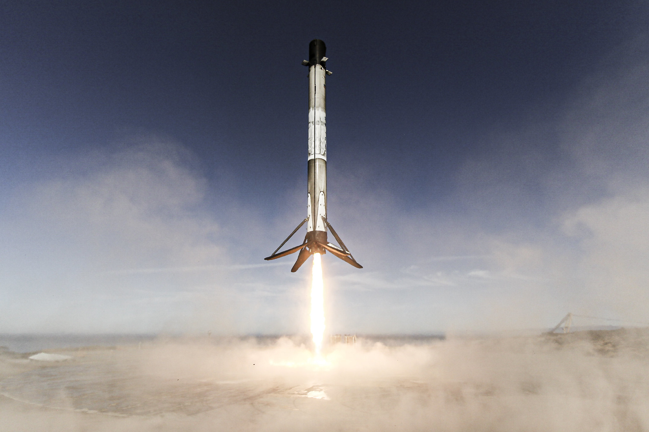
Introduction
Background:
Commercial Space Age is Here
Space X has best pricing ($62 million vs. $165 million)
Largely due to ability to recover part of rocket (Stage 1)
Space Y wants to compete with Space X
Space Y that would like to compete with SpaceX
Problem
Our job is to determine the price of each launch.
We will gather information about Space X and create dashboards for our team.
We will also determine if SpaceX will reuse the first stage if the first stage will land successfully.
We will train a machine learning model and use public information to predict if SpaceX will reuse the first stage.

Slide 5


Slide 6
Methodology
Executive Summary
Data collection methodology:
We gathered data from SpaceX public API and SpaceX Wikipedia page
Perform data wrangling
Cleaned our Data and classify true landings as successful and unsuccessful
Perform exploratory data analysis (EDA) using visualization and SQL
Perform interactive visual analytics using Folium and Plotly Dash
Perform predictive analysis using classification models
Build 4 classification models and tuned them using GridSearchCV

Slide 7
Data Collection
We used a combination of API requests from :
Space X public API
Web scraping data from Space X’s Wikipedia Page.
The next slides will show:
The flowchart of data collection from API
The flowchart of data collection from webscraping.

Slide 8
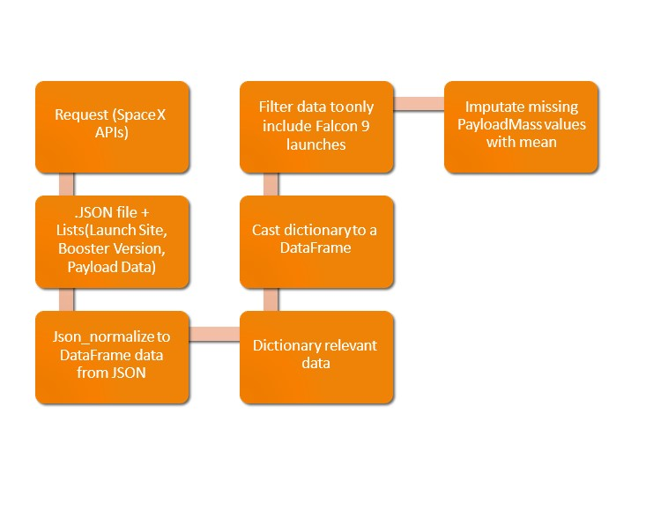
Space X API Data Columns:
FlightNumber, Date, BoosterVersion, PayloadMass, Orbit, LaunchSite, Outcome, Flights, GridFins,
Reused, Legs, LandingPad, Block, ReusedCount, Serial, Longitude, Latitude
GitHub URL

Slide 9
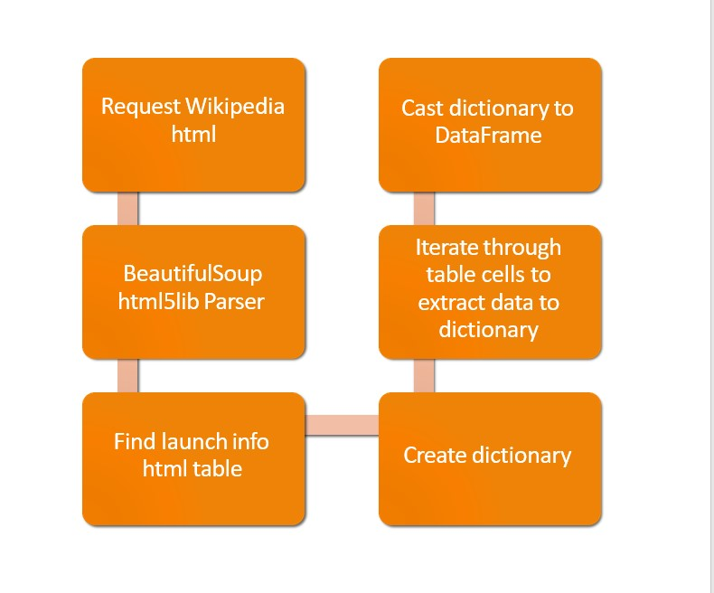
Wikipedia Webscraping Data Columns:
Flight No., Launch site, Payload, PayloadMass, Orbit, Customer, Launch outcome, Version Booster, Booster landing, Date, Time
GitHub URL

Slide 10
Data Wrangling
Replace Nan values with the mean
Create a training label with landing outcomes where successful = 1 & failure = 0.
Outcome column has two components: ‘Mission Outcome’ ‘Landing Location’
New training label column ‘class’ with a value of 1 if ‘Mission Outcome’ is True and 0 otherwise.
Value Mapping:
True ASDS, True RTLS, & True Ocean – -> 1
None None, False ASDS, None ASDS, False Ocean, False RTLS --> 0
See more on GitHub

Slide 11
EDA with Data Visualization
Exploratory Data Analysis performed on variables:
Flight Number
Payload Mass
Launch Site
Orbit
Class and Year.
Plots Used: Flight Number vs. Payload Mass, Flight Number vs. Launch Site, Payload Mass vs. Launch Site, Orbit vs. Success Rate, Flight Number vs. Orbit, Payload vs Orbit, and Success Yearly Trend
Scatter plots, line charts, and bar plots were the best tool to use in order to compare relationships and find correlation between variables so that they could be used in training the machine learning model
GitHub URL

Slide 12
EDA with SQL
Loaded data set into IBM DB2 Database.
Queried using SQL Python integration.
Queries were made to get a better understanding of the dataset.
Queried information about launch site names, mission outcomes, various pay load sizes of customers and booster versions, and landing outcomes
GitHub URL

Slide 13
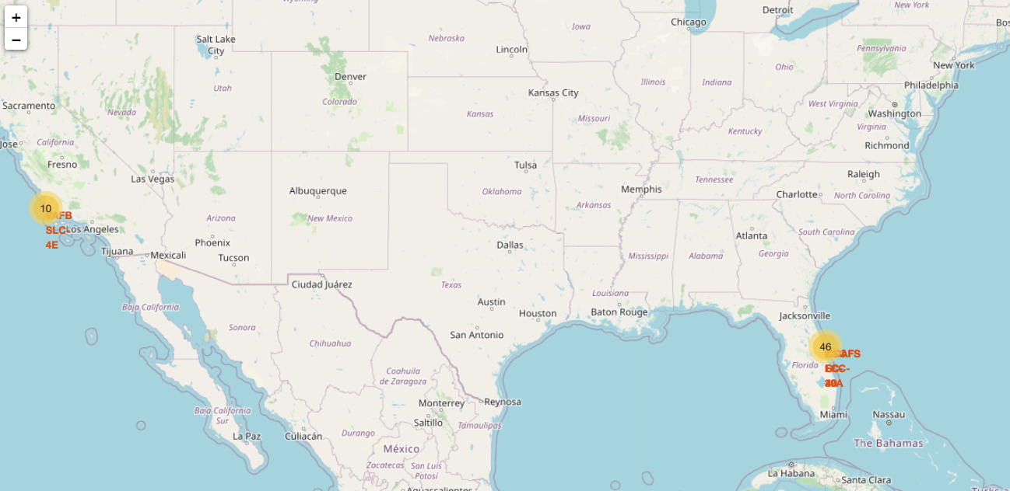
Build an Interactive Map with Folium
Folium maps mark Launch Sites, successful and unsuccessful landings, and a proximity example to key locations: Railway, Highway, Coast, and City.
This allows us to understand why launch sites may be located and where they are.
Also we visualized successful landings relative to location.
GitHub URL

Slide 14
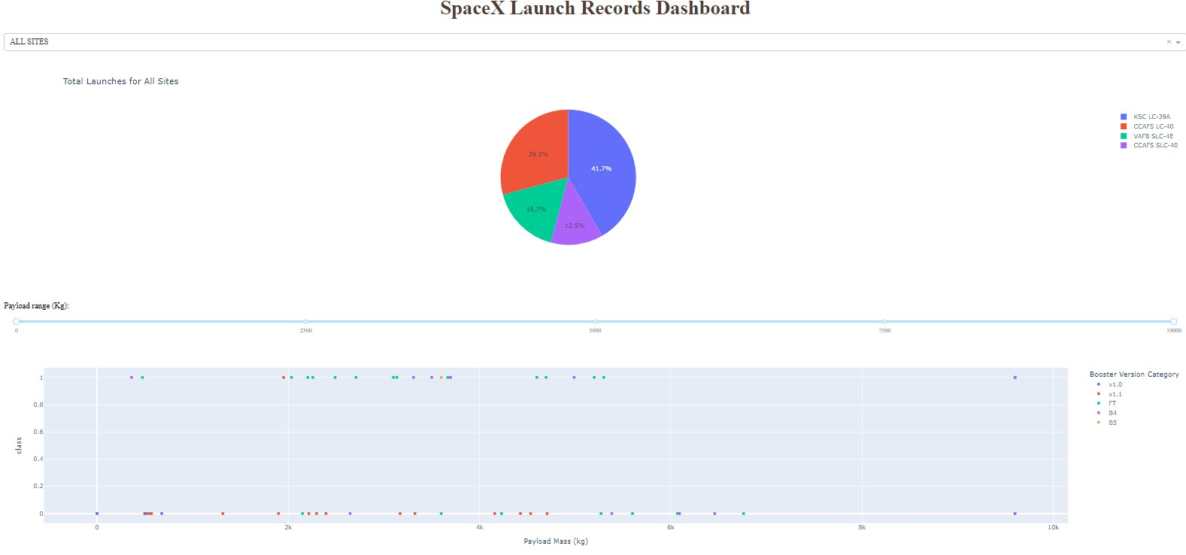
Build a Dashboard with Plotly Dash
Dashboard includes a pie chart and a scatter plot.
Pie chart can be selected to show distribution of successful landings across all launch sites and can be selected to show individual launch site success rates.
Scatter plot takes two inputs: All sites or individual site and payload mass on a slider between 0 and 10000 kg.
The pie chart is used to visualize launch site success rate.
The scatter plot can help us see how success varies across launch sites, payload mass, and booster version category.
GITHUB URL

Slide 15
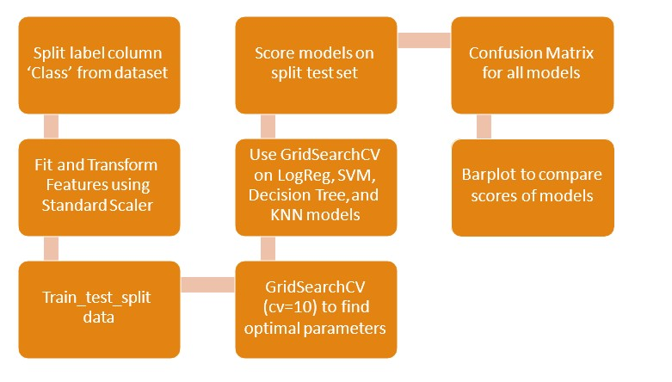
Predictive Analysis (Classification)
GITHUB URL

Slide 16


Slide 17
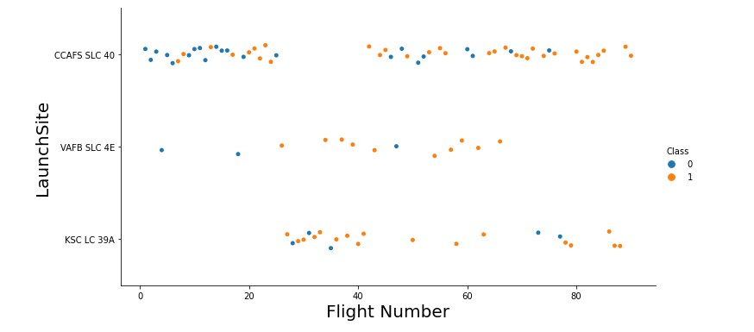
Flight Number vs. Launch Site
Graphic suggests an increase in success rate over time (indicated in Flight Number). Likely a big breakthrough around flight 20 which significantly increased success rate. CCAFS appears to be the main launch site as it has the most volume.

Slide 18
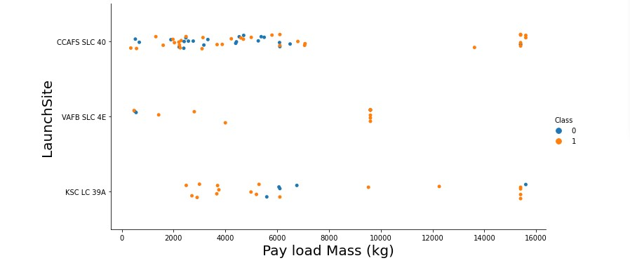
Payload vs. Launch Site
Payload mass appears to fall mostly between 0-6000 kg. Different launch sites also seem to use different payload mass.

Slide 19
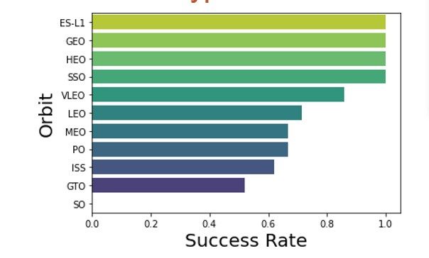
Success Rate vs. Orbit Type
ES-L1 , GEO , HEO , SSO have 100% success rate
VLEO has decent success rate and attempts
SO has 0% success rate
GTO has moderate success rate

Slide 20
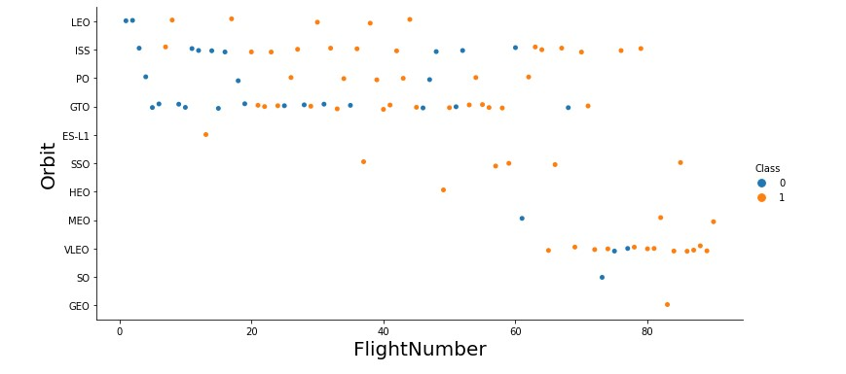
Flight Number vs. Orbit Type
We see that in the LEO orbit the Success appears related to the number of flights; on the other hand, there seems to be no relationship between flight number when in GTO orbit.

Slide 21
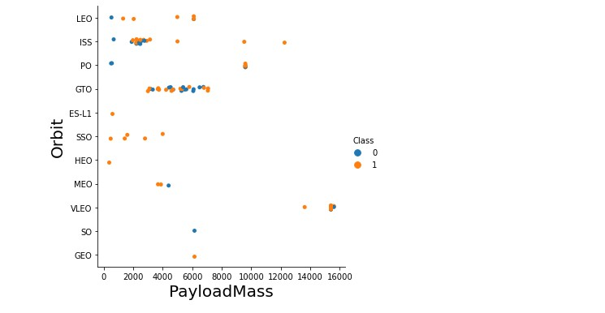
Payload vs. Orbit Type
With heavy payloads the successful landing or positive landing rate are more for Polar, LEO and ISS.
However for GTO we cannot distinguish this well as both positive landing rate and negative landing(unsuccessful mission) are both there here.

Slide 22
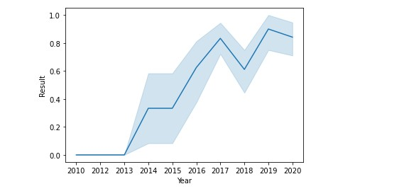
Launch Success Yearly Trend
We observe that the success rate since 2013 kept increasing till 2020
It is also evident that last years success rate is approximately 80%

Slide 23
Results
This is a preview of the Plotly dashboard. The following sides will show the results of EDA with visualization, EDA with SQL, Interactive Map with Folium, and finally the results of our model with about 83% accuracy.

Slide 24
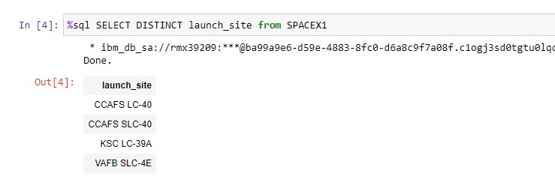
Launch Site Names Begin with 'CCA'
All Launch Site Names
Find the names of the unique launch sites
Present your query result with a short explanation here
As the result illustrate the unique launch sites are 4

Slide 25
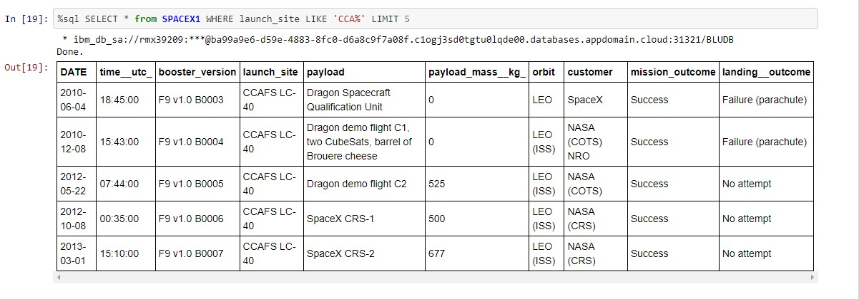
5 Records where launch sites begin with the 'CCA'
All Launch Site Names
Find the names of the unique launch sites
Present your query result with a short explanation here
All five of the records has the same launch site and we also notice the different info we can get from the table.

Slide 26
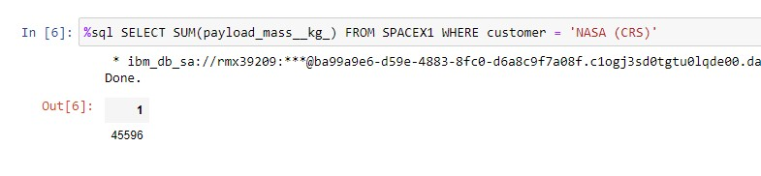
Total Payload Mass
All Launch Site Names
Find the names of the unique launch sites
Present your query result with a short explanation here
Total payload mass in kg where customer is NASA (CRS)
CRS stands for Cargo Resupply

Slide 27
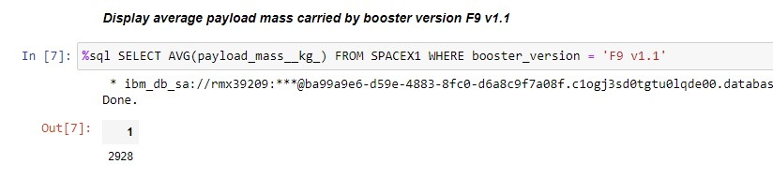
Average Payload Mass by F9 v1.1
All Launch Site Names
Find the names of the unique launch sites
Present your query result with a short explanation here
It seems like version F9 v1.1 carries on average 2928 kg

Slide 28
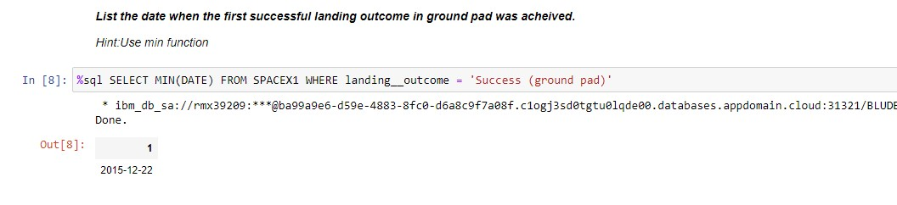
All Launch Site Names
First Successful Ground Landing Date
Find the names of the unique launch sites
Present your query result with a short explanation here
After years of hard work in 22-12-2015 first successful landing with ground pad was achieved.

Slide 29
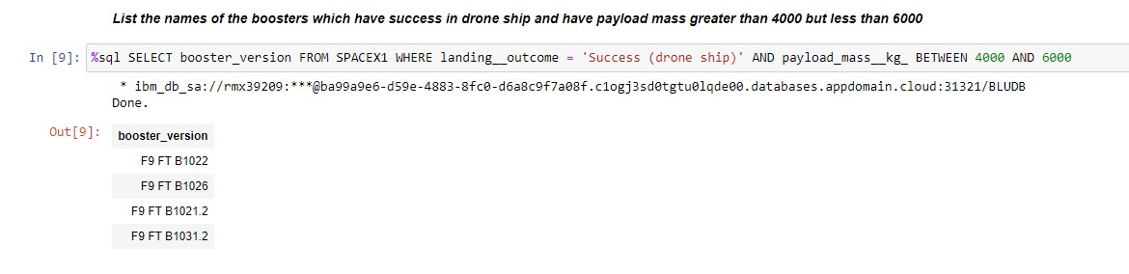
All Launch Site Names
Successful Drone Ship Landing with Payload between 4000 and 6000
Find the names of the unique launch sites
Present your query result with a short explanation here
Only four boosters with moderate Payload have landed successfully in drone ship

Slide 30
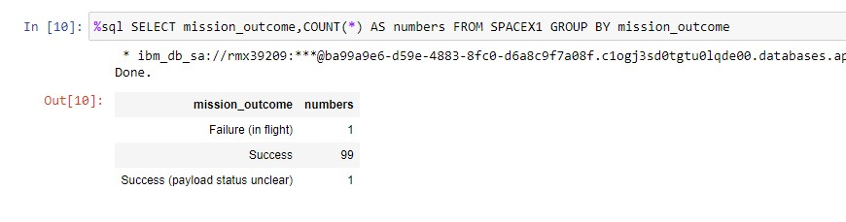
All Launch Site Names
Total Number of Successful and Failure Mission Outcomes
Find the names of the unique launch sites
Present your query result with a short explanation here
99% of missions where a success with only 1 % being a failures.

Slide 31
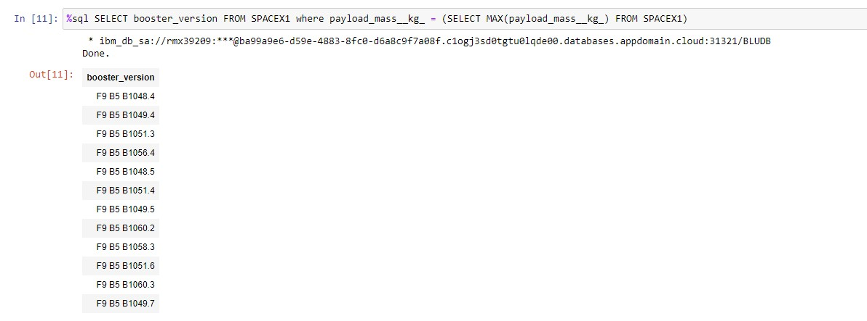
All Launch Site Names
Boosters Carried Maximum Payload
Find the names of the unique launch sites
Present your query result with a short explanation here
The results showed us that 12% of Boosters carried maximum weight with most of them being type 4.

Slide 32
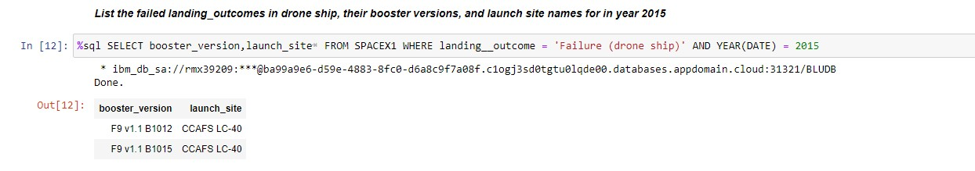
All Launch Site Names
2015 Launch Records
Find the names of the unique launch sites
Present your query result with a short explanation here
In 2015 it is noticed that there were two landing outcomes in drone ship.

Slide 33
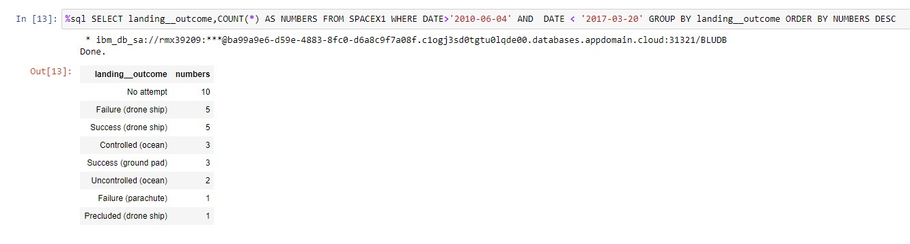
All Launch Site Names
Rank Landing Outcomes Between 2010-06-04 and 2017-03-20
Find the names of the unique launch sites
Present your query result with a short explanation here
This data frame represents the landing outcomes between 2010-06-04 and 2017-03-20 .
It is evident that most outcomes were ‘No attempt’ with drone ship landings being also popular.

Slide 34


Slide 35
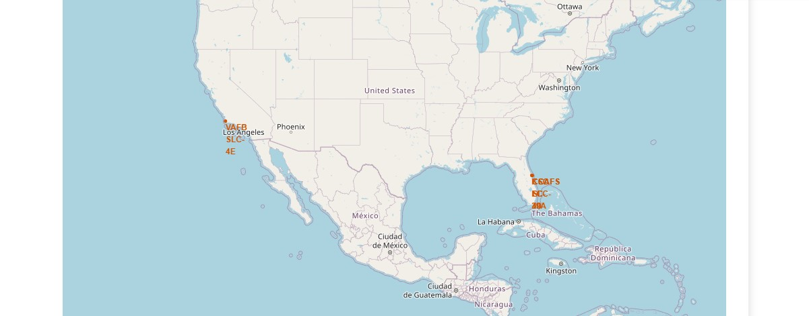
Launch Sites Locations
<Folium Map Screenshot 1>
Replace <Folium map screenshot 1> title with an appropriate title
Explore the generated folium map and make a proper screenshot to include all launch sites’ location markers on a global map
Explain the important elements and findings on the screenshot
From the map we notice the following things:
All launch sites are in proximity to the Equator line
All launch sites are in very close proximity to the coast for safety reasons in the event of failure

Slide 36
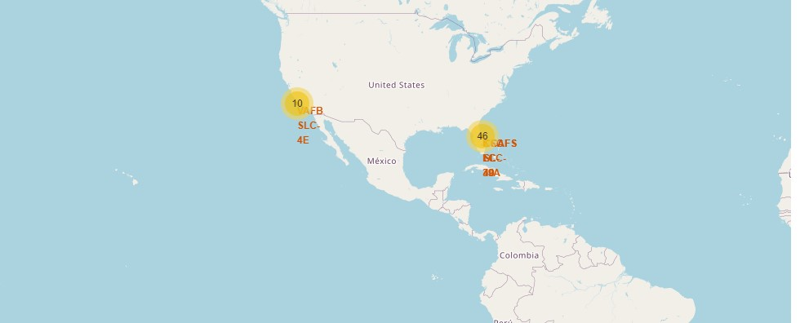
Number of Lunches
<Folium Map Screenshot 1>
Replace <Folium map screenshot 1> title with an appropriate title
Explore the generated folium map and make a proper screenshot to include all launch sites’ location markers on a global map
Explain the important elements and findings on the screenshot
This map counts the number of lunches that took place to a specific area
It is clear that most lunches 80% take place in East Coast

Slide 37
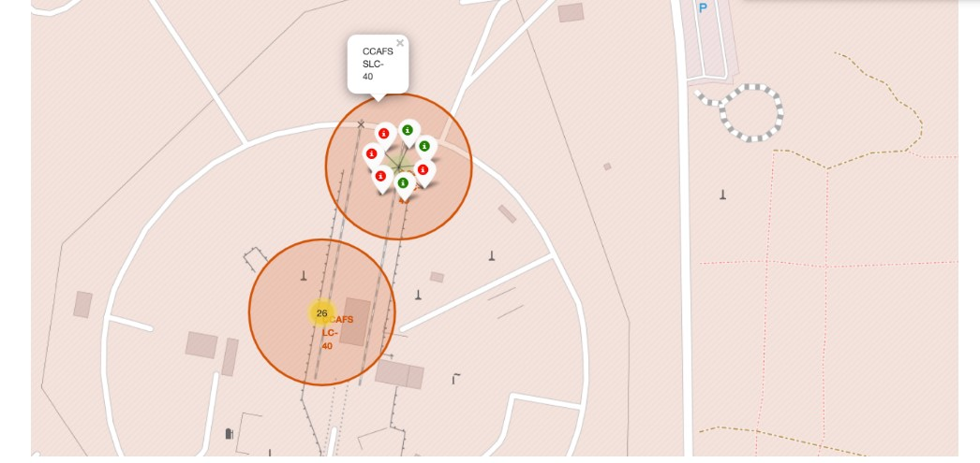
Lunches Outcomes
<Folium Map Screenshot 1>
Replace <Folium map screenshot 1> title with an appropriate title
Explore the generated folium map and make a proper screenshot to include all launch sites’ location markers on a global map
Explain the important elements and findings on the screenshot
This map shows us the lunch outcome we have green for success and red for failure

Slide 38
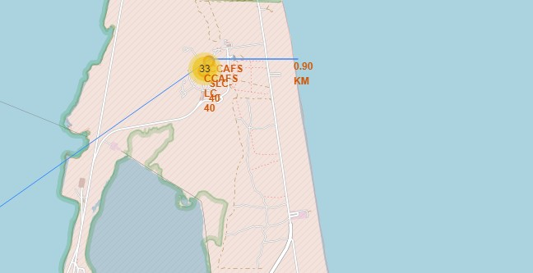
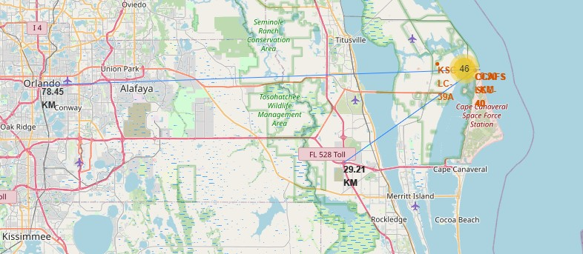
Launch sites proximities
<Folium Map Screenshot 1>
Replace <Folium map screenshot 1> title with an appropriate title
Explore the generated folium map and make a proper screenshot to include all launch sites’ location markers on a global map
Explain the important elements and findings on the screenshot
Distance to coastline – 0.9 KM
Distance to Highway– 29.21 KM
Distance to City– 78.45 KM

Slide 39


Slide 40
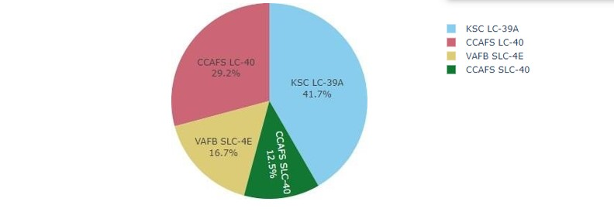
Successful Launches Across Launch Sites
<Dashboard Screenshot 1>
Replace <Dashboard screenshot 1> title with an appropriate title
Show the screenshot of launch success count for all sites, in a piechart
Explain the important elements and findings on the screenshot
This is the distribution of successful landings across all launch sites. Majority of the successful landings where performed by KSC LC 39A.

Slide 41
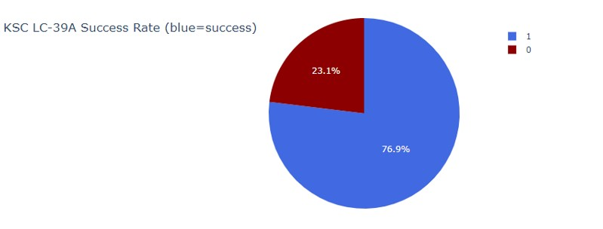
Highest Success Rate Launch Site
<Dashboard Screenshot 1>
Replace <Dashboard screenshot 1> title with an appropriate title
Show the screenshot of launch success count for all sites, in a piechart
Explain the important elements and findings on the screenshot
KSC LC 39A has also the highest success rate with only 3 unsuccessful landings

Slide 42
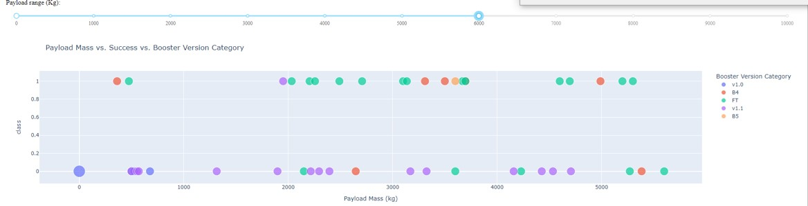
Payload Mass vs. Success vs. Booster Version Category
<Dashboard Screenshot 1>
Replace <Dashboard screenshot 1> title with an appropriate title
Show the screenshot of launch success count for all sites, in a piechart
Explain the important elements and findings on the screenshot
Class = 1 successful landing.
Class = 0 failed landing.
Also it seems like Boosters B4 & FT are the more successful ones

Slide 43


Slide 44
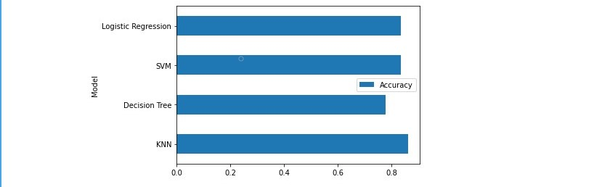
Classification Accuracy
Classification Accuracy
Visualize the built model accuracy for all built classification models, in a bar chart
Find which model has the highest classification accuracy
At the test set all models had decent accuracy (over 70%).
However, the most significant one was KNN with almost 87% accuracy.
It should be noted that test set was pretty small (18 samples) this can cause large variance in our results, such as those in Decision Tree Classifier model in repeated runs. It is possible that we need more data to determine the best model.

Slide 45
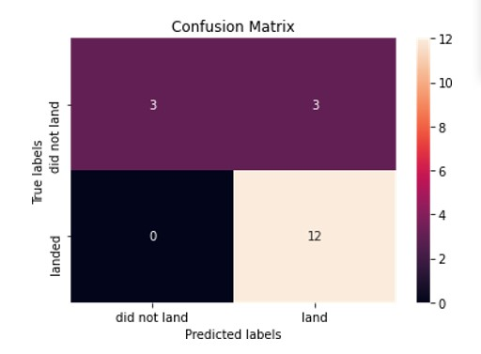
Confusion Matrix
Classification Accuracy
Visualize the built model accuracy for all built classification models, in a bar chart
Find which model has the highest classification accuracy
Confusion Matrix was almost identical with all models.
This Matrix shows that Type I and Type II errors.
Our model has only Type II errors meaning that it predicted that it will not land but in reality it landed

Slide 46
Conclusions
Conclusions
Our task was to develop a machine learning model for Space Y who wants to compete against SpaceX
Our goal was to create a model to predict when Stage 1 will successfully land to save almost $100 million USD
We gathered data from SpaceX API and with web scraping from SpaceX Wikipedia page
We created data labels and stored data into a DB2 SQL database
Created a dashboard for Interactive visualization
We created a machine learning model with an accuracy of 83%
Finaly, we are now able to use this model to predict with relatively high accuracy whether a launch will have a successful Stage 1 landing before launch to determine whether the launch should be made or not
We recommend that more data should be collected to optimize the best machine learning model and improve accuracy
Point 1
Point 2
Point 3
Point 4
…

Slide 47
Appendix
Conclusions
Special Thanks to all Instructors:
Instructors: Rav Ahuja, Alex Aklson, Aije Egwaikhide, Svetlana Levitan, Romeo Kienzler, Polong Lin, Joseph Santarcangelo, Azim Hirjani, Hima Vasudevan, Saishruthi Swaminathan, Saeed Aghabozorgi, Yan Luo
Point 1
Point 2
Point 3
Point 4
…
GitHub URL for Full Project
https://www.coursera.org/professional-certificates/ibm-data-science?&instructors#instructors
SPACEX API URL

Slide 48


